Slide 1
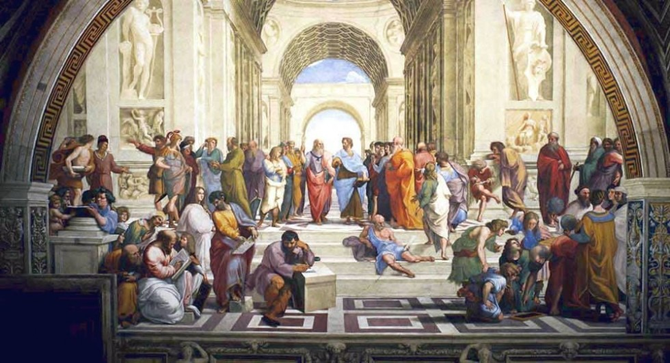
A historical review of contemporary logic origins
Made by
Second-year Student of IASA
Oleksii Kosiuk

Slide 2
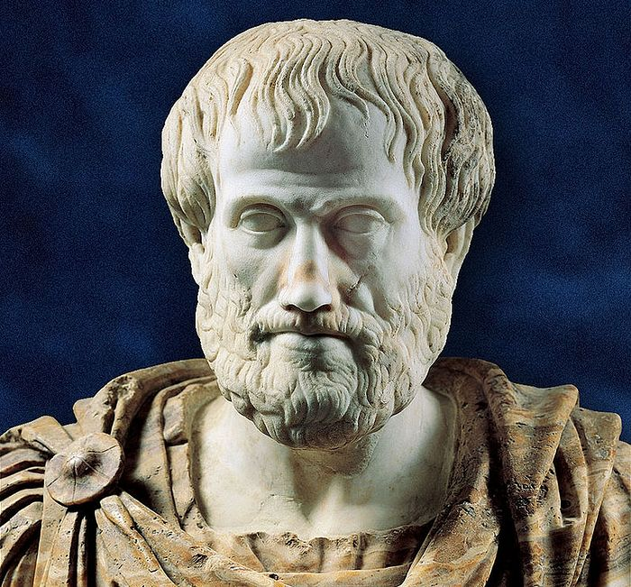
The birth of logic
Logic, which studies cognitive thinking and is used as a means of cognition, arose and developed as a philosophical science. It was formed over two thousand years ago, in the IV century. BC e. Its founder is the ancient Greek philosopher Aristotle (384-322 BC , who discovered 3 main logical laws.
Aristotle

Slide 3
Laws of Aristotle
1. Identity law
Every statement or thought should be equal to itself and have no other meanings: “If A is A, then A = A and all other statements are not equal to A”.
Example of violation
I’ve broken my hand in two places.
Don’t visit this places anymore.
“Place” means both fracture site and location of the person, when he/she had broken his/her hand. It leads to missunderstanding.

Slide 4
Laws of Aristotle
2. Law of non-contradiction
If one judgment asserts something, and another denies the same thing about the same object at the same time and in the same respect, then they cannot be true at the same time: “If A is true, than not-A is false and vice versa.”
Example of violation
There’s black hair on the floor because of this rude cat.
From childhood: “Close your mouth and eat.”

Slide 5
Laws of Aristotle
3. Law of excluded middle(of excluded third)
Two contradicting statements about particular object and in particular relation can’t be both true or both false at the same time: “If B = not-A and A is true then B can’t be true.”
Example of violation
The judgments “old cat” and “not old cat” about the same cat at the same time cannot be simultaneously correct.
Don’t confuse two concepts: opposite(“big house”, “small house”: “house of average size” is the middle), contradicting(“big house”, “not big house”, there’s no middle statement).

Slide 6
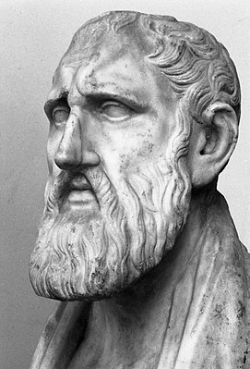
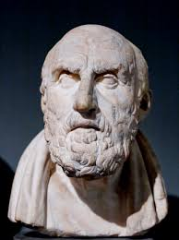
Antique stoics and logic of propositions
Propositional logic, also known as sentential logic and statement logic, is the branch of logic that studies ways of joining and/or modifying entire propositions, statements or sentences to form more complicated propositions. Complex assertions are determined by truth/non-truth of their simple compounds.
Antique stoics
Zeno
Chrysippus

Slide 7
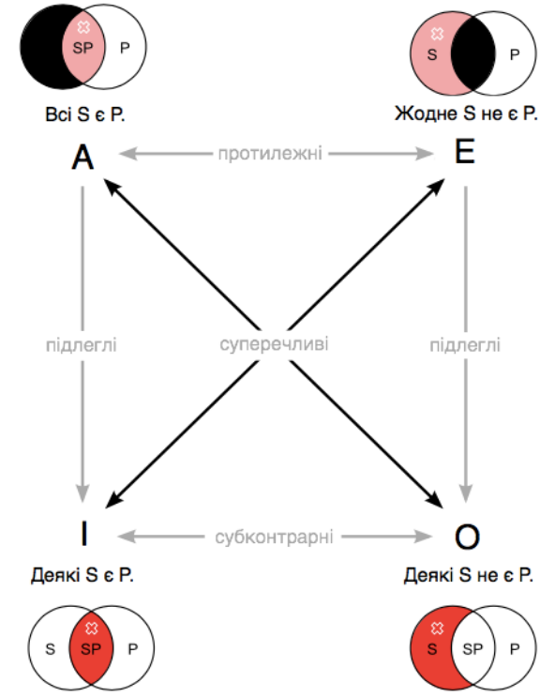
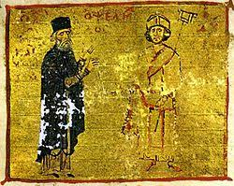
Medieval development of logic
Logic developed in the Middle Ages, but scholasticism distorted the teachings of Aristotle, adapting it to substantiate religious dogma. So most major discoveries were made in eastern countries.
Logical rectangle
Mikhailo Psell

Slide 8
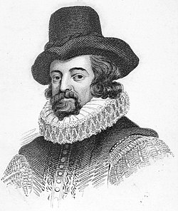
Logic in XV – XVII centuries
Significant successes of logical science in modern times. The most important stage in its development was the theory of induction, developed by the English philosopher F. Bacon (1561-1626).
Bacon developed the methods of scientific induction, systematized later by the English philosopher and logician JS Mill (1806-1873).
Francis Bacon

Slide 9
Beacon’s method and Theory of Induction
Bacon's method is an inductive method of cognition, presented by F. Bacon in the work "New Organon" (1620). According to Bacon, experience is the best of all evidence, if it is rooted in experiment. However, "the experiential cognition that humans generally use is blind and has four drawbacks:
1. unreliability of impressions of the senses itself
2. uncertainty and poor distraction of concepts from the impressions of the senses
3. conclusion about the basics of science by means of a simple listing
4. discovery and verification, when at first the most general foundations are built, and then, by means of them, the middle axioms are verified.

Slide 10
Forms identifying
According to Bacon, there is nothing real in nature, apart from individual bodies that carry out, in accordance with the law, separate pure actions. Forms Bacon calls this law and its subdivisions.
The point and purpose of human knowledge is to discover the form of a given nature, or a true difference, or a producing nature, or a source of origin (for these are the words we have that come closest to designating this goal.
Bacon repeatedly warns that no one will successfully find the nature of a thing in the thing itself - the study should be expanded to a more general one, since what is considered hidden in some things, in others has a clear and ordinary nature. In addition, Bacon argues that knowing the cause of any nature (for example, whiteness or warmth) only in some objects is imperfect. Knowledge of the same form embraces the unity of nature in dissimilar matters.

Slide 11
Heat form identifying example
From all examples and from each of them it is clear that nature, a particular case of which is heat, is motion. The true differences that make a certain movement and lead it to the form of heat are the following:
heat is a movement in which the body tends to expand, while such that the body simultaneously tends upward;
heat is not a movement of uniform expansion of the entire mass, but expansion in the smallest particles of the body;
this movement of piercing and penetration is rather fast and not slow.

Slide 12
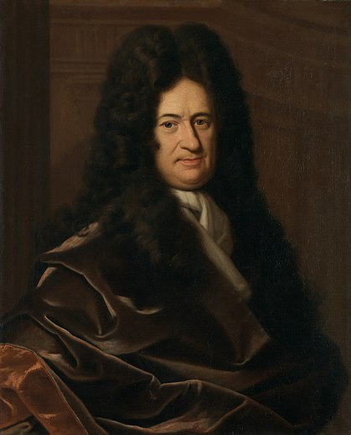
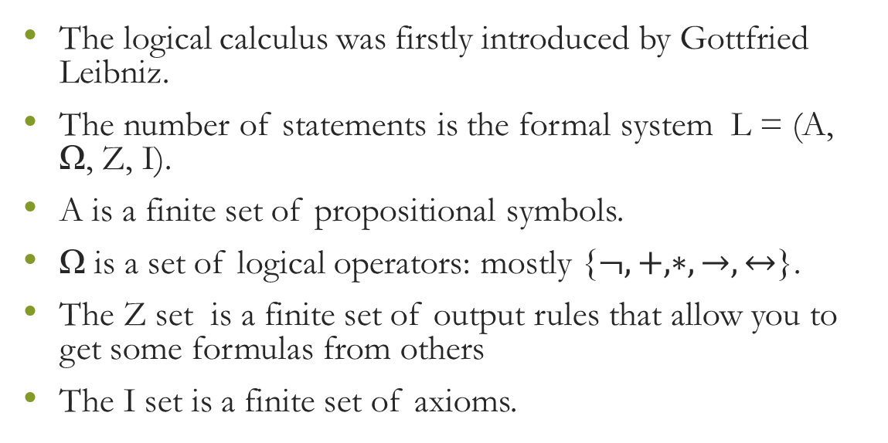
The logical calculus
The logical calculus was firstly introduced by Gottfried Leibniz.
The number of statements is the formal system L = (A, Ω, Z, I).
A is a finite set of propositional symbols.
Ω is a set of logical operators: mostly {$¬, +, ∗, →, ↔$}.
The Z set is a finite set of output rules that allow you to get some formulas from others
The I set is a finite set of axioms.
Gottfried Leibniz

Slide 13
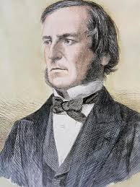
Boolean algebra
George Boole:
introduced the algebra of logic (namely, the laws of addition, multiplication, distribution and absorption applied to human thought);
expanded the two-term propositions of Aristotle’s logic to whatever range;
provided Aristotle’s logic with mathematical basis (namely, introducing the equations);
introduced the concept of ‘the universe of discourse’;
George Boole

Slide 14
Modern logic science
Symbolic logic is an intensively developing field of logical research, including many sections, or, as they are called, "logic" (for example, the logic of statements, the logic of predicates, probabilistic logic, etc.). Much attention is paid to the development of multivalued logic, in which, in addition to the two values ​​of truth accepted in traditional logic - "true" and "false" - many values ​​of truth are allowed. Thus, in the three-digit logic developed by the Polish logician J. Lukasevich (1878-1956), a third meaning is introduced - "possible" ("neutral").
Promising are such sections as probabilistic logic, which studies statements that take many degrees of plausibility - from 0 to 1, temporal logic and many others.

